Slide 1
Owners’ equity; Dividends and Earnings per share (EPS)

Slide 2
Stock Ownership: Benefits and Risks
Benefits:
Ownership and residual claim on company’s assets
Dividends and capital gains
Voting rights
Risks:
Return – not promised nor guaranteed
Market volatility
Dilution

Slide 3
Owners’ financing – components
Contributed capital – proceeds from stock issuances, net of amounts paid to repurchase shares.
Earned capital – cumulative retained earnings (RE) and accumulated other comprehensive income (AOCI).
Current RE = Prior RE plus Net Income minus Dividends

Slide 4
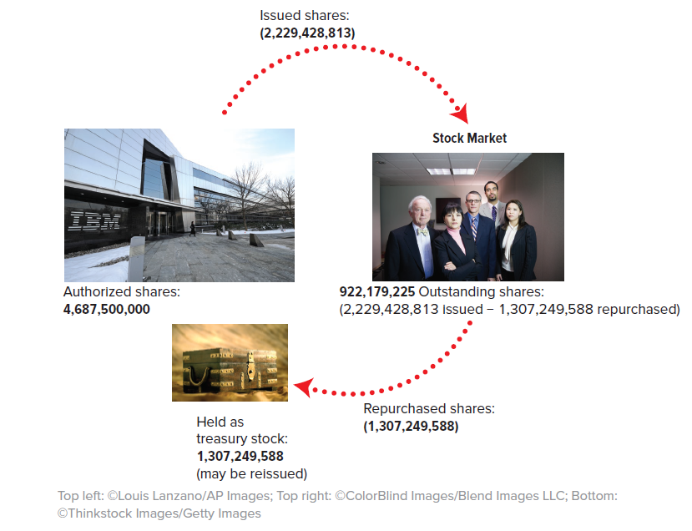
Authorized, issued and outstanding shares

Slide 5
Share issuance
Shares issuance (ongoing):
Increase the shares outstanding
Increase in cash and increase in equity
Do NOT affect net income
Special case – Initial Public Offering (IPO): same accounting, greater disclosure

Slide 6
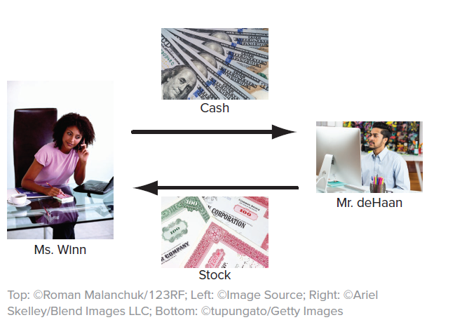
Trading at the secondary markets
Subsequent to the initial sale, investors trade among themselves without directly affecting the corporation.

Slide 7
Cash dividends
Cash Dividend:
Regular $ payment for each share outstanding
Decrease in cash and decrease in equity
No impact on net income
No impact on shares outstanding
Are dividends always beneficial for the shareholders?

Slide 8
Share repurchases
Shares repurchases:
Remove shares outstanding from the market
Decrease in cash and decrease in equity
No impact on net income
Decrease in shares outstanding and increase in the EPS
Are share repurchases beneficial for the shareholders?

